Slide 1
Breakfast, lunch, dinner

Slide 2
We are going to
practice our active vocabulary,
develop reading,
speaking,
listening skills.

Slide 3
ng = [ ]

Slide 4
ch = [ ]

Slide 5
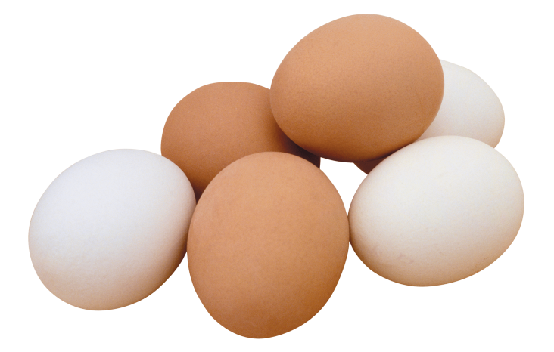
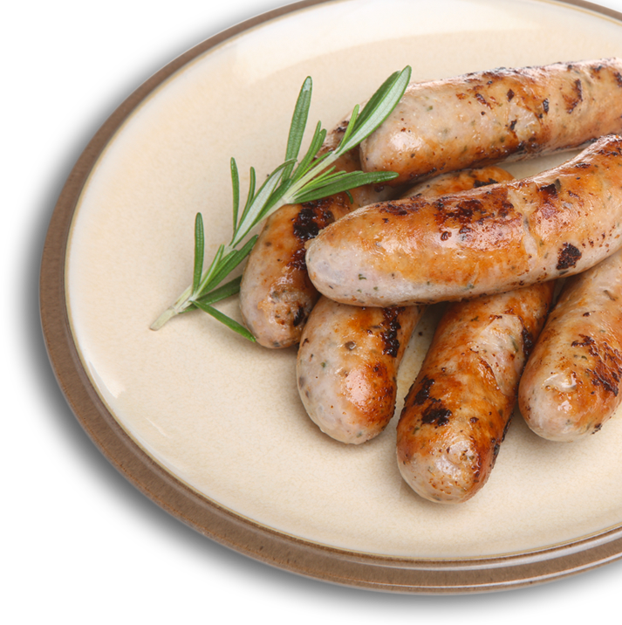
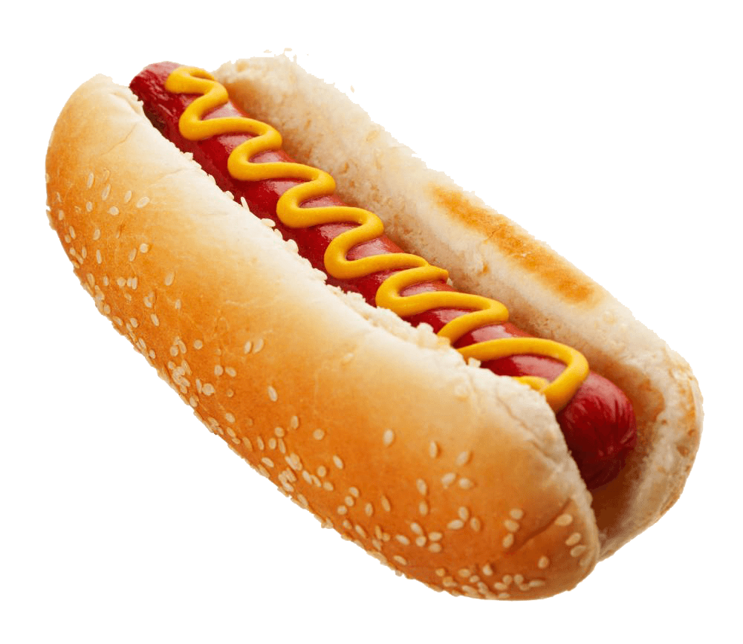
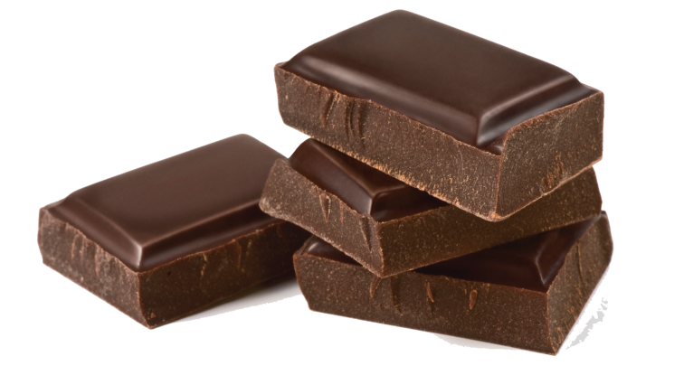

Slide 6
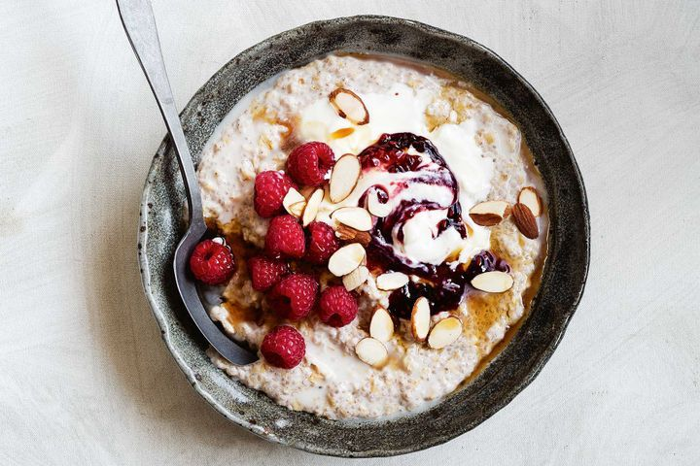
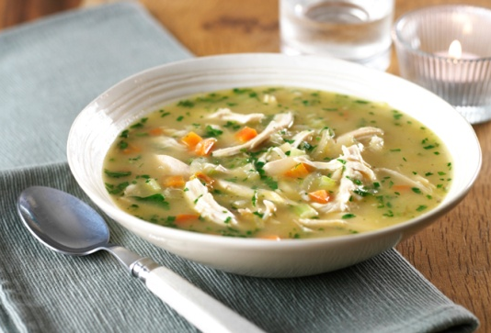
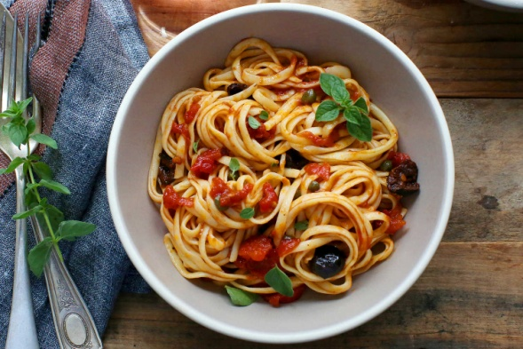
I have for .
I have for .
I have for .

Slide 7
ordpgeri
porridge

Slide 8
pasta
aaspt

Slide 9
tsafkaerb
breakfast

Slide 10
sehciwdnas
sandwiches

Slide 11
lunch
hcnul

Slide 12
What do you have for breakfast/lunch/dinner?
porridge soup
pasta
sandwiches breakfast.
fish
I have eggs for lunch.
coffee
tea dinner.
meat
chicken
potatoes
I have fish for dinner.

Slide 15
Look up
Look down
To the left
To the right
To the sky
To the ground
Wink, wink, wink
It's all right.

Slide 17
We have ________ in the morning.
We have ________ in the evening.
We have ________ in the afternoon.

Slide 18
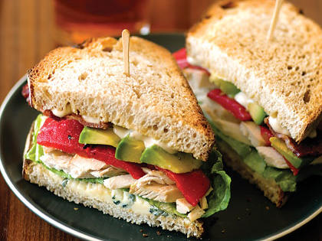

Slide 19
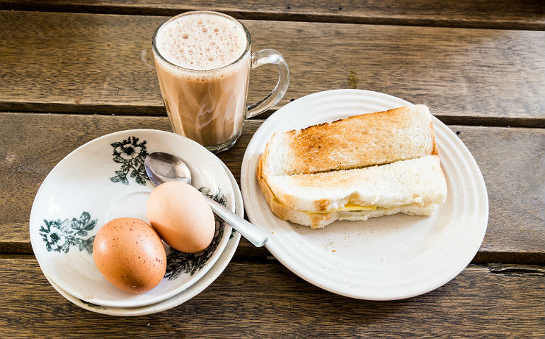
Twinky has breakfast in the morning.
He has eggs, sandwiches and coffee for breakfast.

Slide 20
H. t. c. 63, упр. 4b

